Slide 1
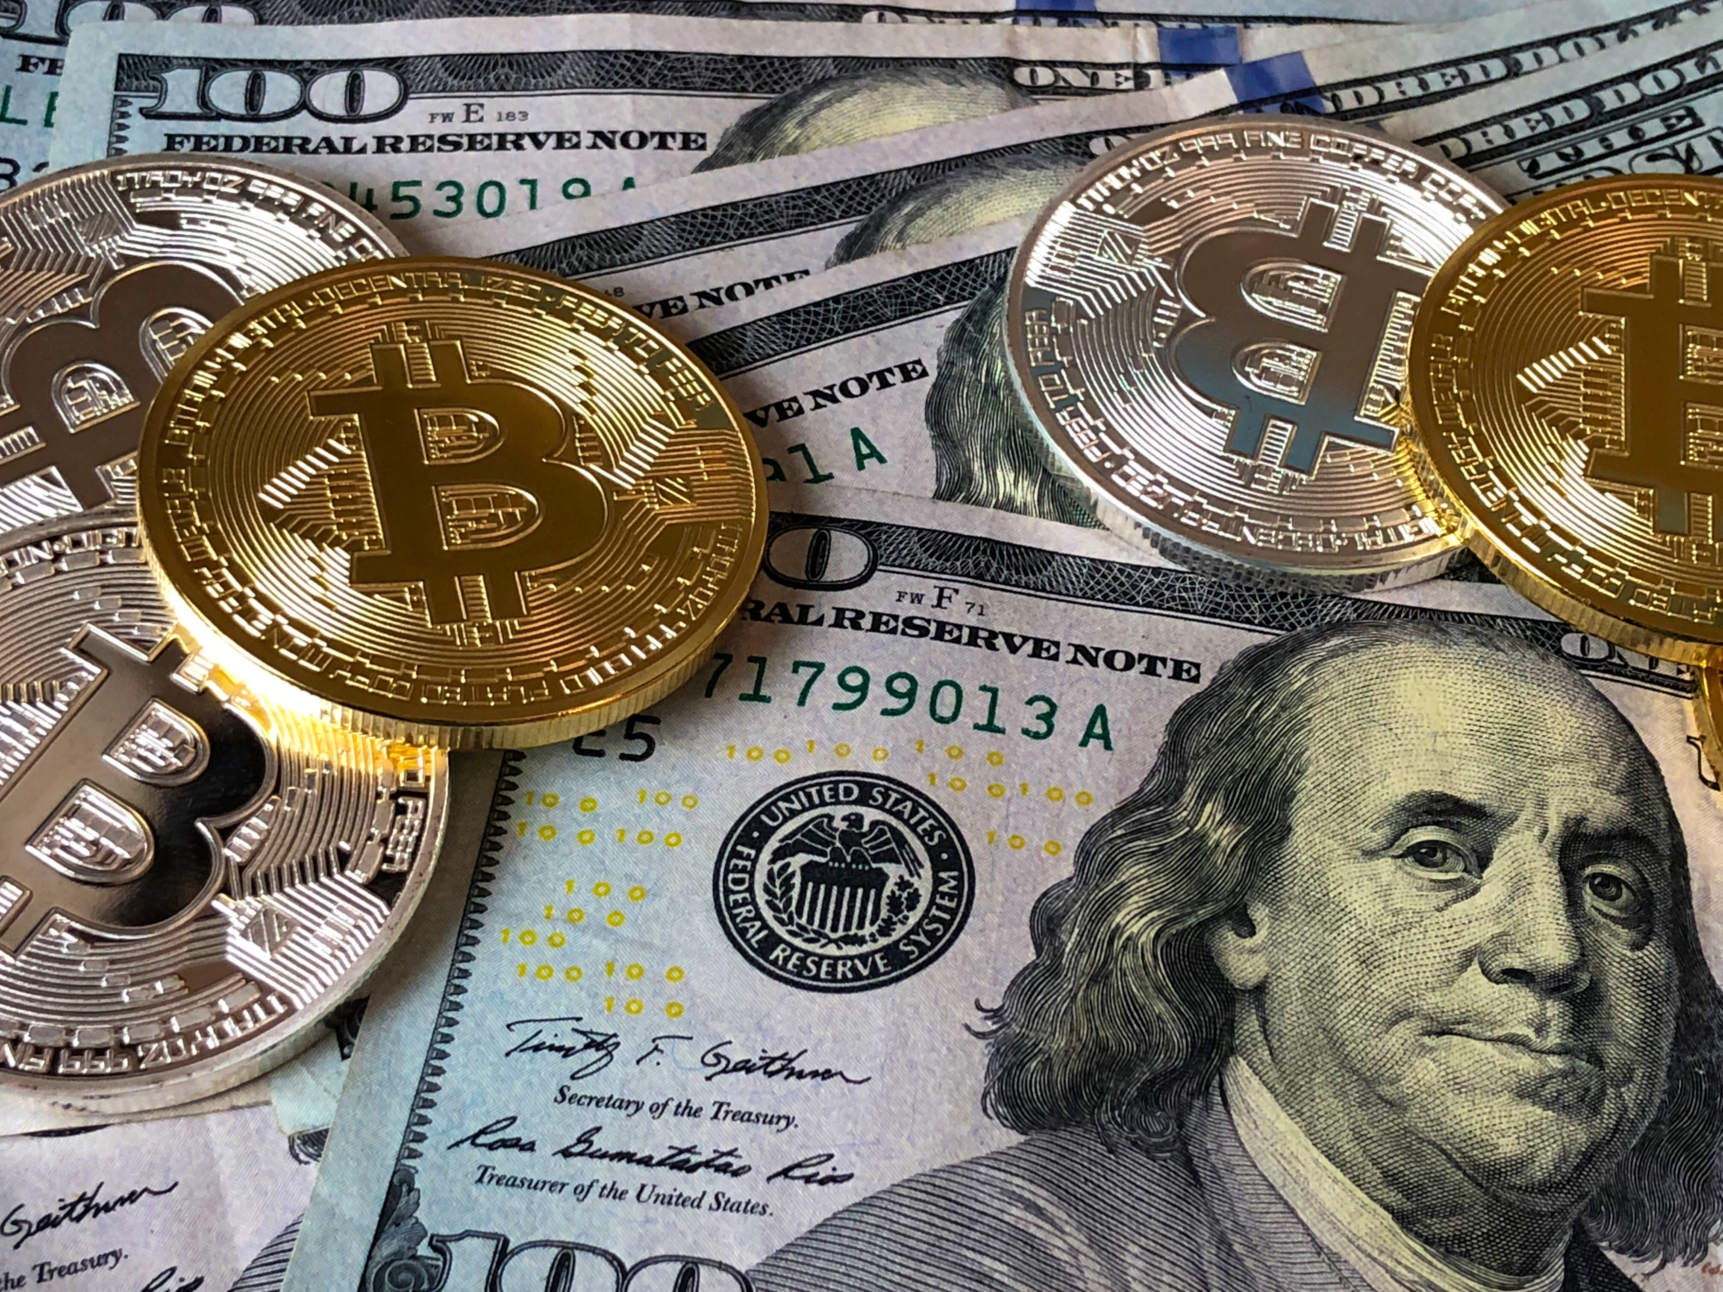
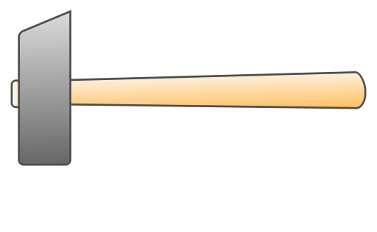

Barclays
Metal and Mining
Manoj
Nishant
Darshan
Sidharth
Divya
Gyaneshwar
Sree Babu
Team 1

Slide 2



$$Index in period t=\frac{Value in period t}{Value in base period}×100$$
Metal Market Update
To Analyse the recent trends on metals we’ve used historical data and applied the concepts of indexing, daily returns, correlation and exploratory statistics.
Indexing: An index shows the development of a number over time. It only shows the change of a figure from one point in time to another. The index is calculated based on some base period, from which onwards the increase is calculated in percentages over the base period
Daily Returns: Daily returns are best used for exploratory statistics and also to find relations between two metals.
$Daily Returns=\frac{Today^{′}sPrice−Yesterday^{′}s Price}{Yesterday^{′}sPrice}×100$:

Slide 3
Metal Market Update
Historical Price Analysis: This is best used to analyse the prices of metals over a period of time
Correlation: Measure of the linear relationship between two variables. We will use this to evaluate the price relation with benchmark metals i.e. gold(precious) and copper(industrial)
 | Platinum | Palladium | Gold | Copper
Platinum | 1
Palladium | 0.740313 | 1
Gold | 0.713323 | 0.510643 | 1
Copper | 0.541158 | 0.618819 | 0.346253 | 1

Slide 4
Events and Impacts
Historical Price Analysis:

Slide 5
Indexing

Slide 6
Indexing

Slide 7
Analysis basis : Quarterly Standard Deviation comparison
Moody's act in Q3-2011 has definitely created volatility in Gold market value, while Gold is considered as safe haven for investors , since the correlation with stocks, bonds is negative.
The volatility persisted in the market as the confidence in the market grew regarding Greece defaulting as we observe in Q1-2012 to Q3-2013
 | Q2-2011 | Q3-2011 | Q4-2011 | Q1-2012 | Q2-2012 | Q3-2012
Gold | 2.098811 | 7.839778 | 3.925711 | 3.110981 | 2.222992 | 4.318741

Slide 8
The market was confused as we observe the volatility, but we watch a gradual increase in investment in platinum as the market gets confident on Greece to default its debt.
Analysis basis : Quarterly Standard Deviation comparison
 | Q2-2011 | Q3-2011 | Q4-2011 | Q1-2012 | Q2-2012 | Q3-2012
Platinum | 2.284367 | 4.918312 | 5.067557 | 6.308433 | 4.311039 | 6.658409

Slide 9
Daily Returns

Slide 10
Daily Return Reports
Positive Daily Returns
Negative Daily Returns
Same Daily Returns

Slide 11
Platinum
Palladium
Gold
Copper

Slide 12
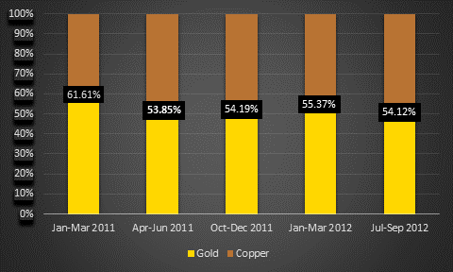
Correlations
Platinum
Time Frames | Gold | Copper
Jan – Mar 2011 | 0.61049 | 0.37919
Apr – Jun 2011 | 0.711195 | 0.592615
Oct – Dec 2011 | 0.84371 | 0.710057
Jan – Mar 2012 | 0.670068 | 0.540925
Jul – Sep 2012 | 0.586145 | 0.500258
In the above Quarterly time frames, platinum behaves to be more of a precious metal than an industrial metal.

Slide 13
Correlations
Jan 2011 – Oct 2012 | Platinum | Palladium | Gold | Copper
Platinum | 1
Palladium | 0.740313 | 1
Gold | 0.713323 | 0.510643 | 1
Copper | 0.541158 | 0.618819 | 0.346253 | 1
Aug 2011 – Oct 2012 | Platinum | Palladium | Gold | Copper
Platinum | 1
Palladium | 0.718243 | 1
Gold | 0.735089 | 0.508343 | 1
Copper | 0.570611 | 0.653172 | 0.372877 | 1
Oct 2011 – Oct 2012 | Platinum | Palladium | Gold | Copper
Platinum | 1
Palladium | 0.731007 | 1
Gold | 0.74234 | 0.615507 | 1
Copper | 0.594172 | 0.640412 | 0.477791 | 1

Slide 14
Palladium Vs Gold – Non Correlation
Jan 2011 – Oct 2012 | Platinum | Palladium | Gold | Copper
Platinum | 1
Palladium | 0.704589 | 1
Gold | 0.773511 | 0.388241 | 1
Copper | 0.573825 | 0.761757 | 0.25663 | 1

Slide 15
SUMMARY OF TOOLS :
Price or historical prices give the exact market price of the metals. This is used when we are analysing the key trends in the market for a single commodity. This does not gives a clear picture, when multiple securities are being compared.
But in our case, the 4 metals are not similar, meaning they have different price ranges and different uses. We are just analysing the trends of each metal, and how one is performing relative to other. To achieve that we have to use Price index. An index shows the development of a difference to index over time. It only shows the change of a figure from one point in time to another. But, the base period is arbitrary, and may miss some key events, without extra knowledge of the events.
Daily returns is even better tool, if we have to look for certain events, as they react quickly and can be captured with ease. And, similar to indexing, it can be used to compare multiple commodities.
It matters which of the tools we use, as they will give different results. As per below charts, we are getting different correlations among metals, if we use historical prices vs the daily Returns data.

Slide 17
VZ
INDEXED CORRELATION
Aug 2011 – Oct 2012 | Platinum | Palladium | Gold | Copper
Platinum | 1
Palladium | 0.9105 | 1
Gold | -0.2183 | -0.420 | 1
Copper | 0.8787 | 0.9404 | -0.494 | 1
HISTORICAL DATA CORRELATION
Aug 2011 – Oct 2012 | Platinum | Palladium | Gold | Copper
Platinum | 1
Palladium | 0.9105 | 1
Gold | -0.2205 | -0.4227 | 1
Copper | 0.8787 | 0.9404 | -0.5000 | 1
DAILY RETURNS CORRELATION
Aug 2011 – Oct 2012 | Platinum | Palladium | Gold | Copper
Platinum | 1
Palladium | 0.740 | 1
Gold | 0.713 | 0.510 | 1
Copper | 0.541 | 0.6188 | 0.346 | 1

Slide 18

SUMMARY
1. Copper prices are more fluctuating than platinum prices, so might not be a good hedging option. Standard deviation on index for platinum is 8.2 and for copper is 8.6, which states copper is more volatile and is a bad hedge for platinum prices.
2. We would suggest to invest in gold as it has highest mean value for index(gold - 113.87 vs platinum - 92.84) which translates to highest mean increase from base value in percentages.
3. For more cash flow, it is suggested to go with gold and for utility of underlying metal in industrial use it is suggested to go with copper.
4. Daily returns have proved to be a better tool for this case study as it provides deeper insights in comparing various metals.
5. Platinum tends to act as a precious metal rather than an industrial metal as it has better correlations with Gold than to Copper.

